Slide 1
SQL Bootcamp
Noble Desktop

Slide 2

SQL
Benefits of learning

Slide 3
1. SQL is evergreen

Slide 4
SQL History
Original spec from 1974
Main features largely unchanged!
By contrast, JS changes every year

Slide 5
2. SQL is consistent

Slide 6
Flavors of SQL
“Know your numbers” for any aspect of your business
Fix mistakes in database
Create backups of your data

Slide 7
3. SQL is Narrow

Slide 8
SQL Use case
Only one purpose: querying data
Can be mastered in weeks
Learning other languages is a never-ending journey

Slide 9
4. SQL is essential
to business

Slide 10
Uses of SQL
“Know your numbers” for any aspect of your business
Ensure backups are working

Slide 11
Course outline

Slide 12

Class format
15 minutes for lesson & demo
15 minutes for exercise
Pause to review & ask questions
Rinse and repeat

Slide 13
Sessions 1 & 2
Connecting to a Database
Navigating the DBeaver GUI
Querying with basic filters

Slide 14
Sessions 3 & 4
Group by queries
Primary and foreign keys
Inner and outer joins

Slide 15
Sessions 5 & 6
Adding data to a database
Creating tables and views
Updates and deletes
Exporting data

Slide 16
Out of scope
Database architecture
Performance optimization
Theoretical foundations

Slide 17
Connecting To a Database

Slide 18
This will be on the test!

Slide 19
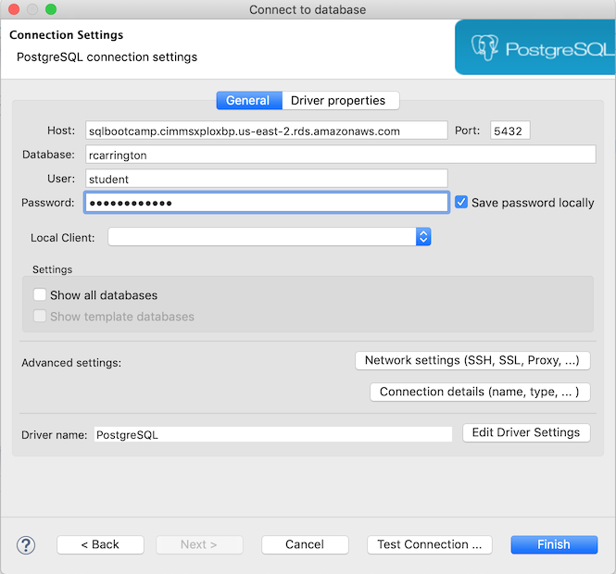

Slide 20


High-Level view
Network
Client
Server/Host

Slide 21

High-Level view

Slide 22
High-Level view
Network
Client
Server/Host

Slide 23

High-Level view
Network
DBeaver
Server/Host

Slide 24

High-Level view
Network
DBeaver
Postgres

Slide 25
High-level view
Client
Server/Host
DBeaver
Postgres

Slide 26

Server view

Slide 27
Server view
Postgres instance

Slide 28
Server view
Network

Slide 29

Server view
Port

Slide 30

“Port 5432?”
“Yes, I’ll connect you to Postgres right away.”

Slide 31

Server view
Database

Slide 32
Server view
Databases

Slide 33
Database view

Slide 34

Database view
Table aka Relation

Slide 35
Database view
Schema = set of tables

Slide 37
Quiz!

Slide 38
DBeaver Interface

Slide 39
DBeaver Interface
Browse the tables within a database
Execute a query
See the resulting data

Slide 40
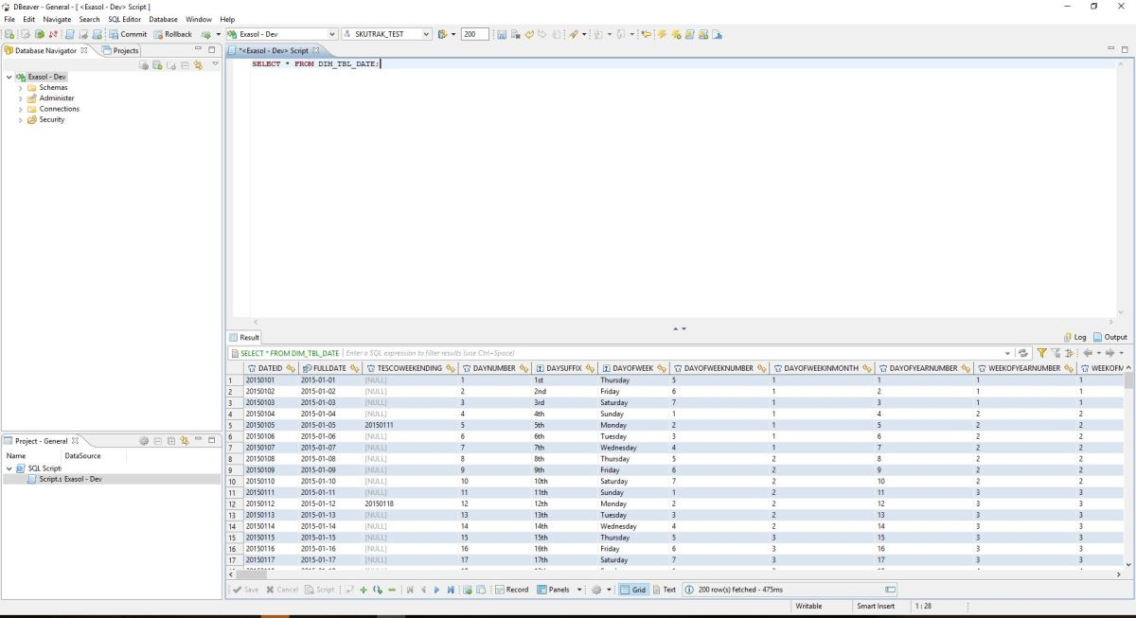
Text

Slide 41
Text
database navigator

Slide 42
Text

Slide 43
Text
SQL editor

Slide 44
Text

Slide 45
Text
Results panel

Slide 46
Walkthrough

Slide 47
Select Statement
SELECT * FROM products;

Slide 48
Select Statement
SELECT * FROM products;
table

Slide 49
Select Statement with Limit
SELECT * FROM products
LIMIT 100;

Slide 50
Specifying Columns
SELECT title, price FROM products;

Slide 51
Specifying Columns
SELECT title, price FROM products;
column

Slide 52
Distinct
SELECT DISTINCT price FROM products

Slide 53
Exercises

Slide 54
Filtering

Slide 55
Examples
Who spent more than $500?
How many customers were from Florida?

Slide 56
Data Type
Assigned to each column
Determines what kinds of queries you can do

Slide 57
Numeric Types
int
smallint
float
numeric, etc

Slide 58
Numeric Filter: Less than
SELECT * FROM products
WHERE price < 1000;

Slide 59
Numeric Filter: Less than or equal to
SELECT * FROM products
WHERE price <= 1000;

Slide 60
Numeric Filter: Less than or equal to
SELECT * FROM products
WHERE price <= 1000;
equals goes after

Slide 61
Numeric Filter: in
SELECT * FROM products
WHERE price in (9.99, 15.99);

Slide 62
Exercises

